Slide 1
AiR (icon to be..)
Ours ampus

Slide 2
AR is the future ..
“..it’s for everyone. I think AR is that big, it’s huge. I get excited because of the things that could be done that could improve a lot of lives. And be entertaining.”
Tim Cook, Feb 2017

Slide 3
This is where AiR comes in.

Slide 4
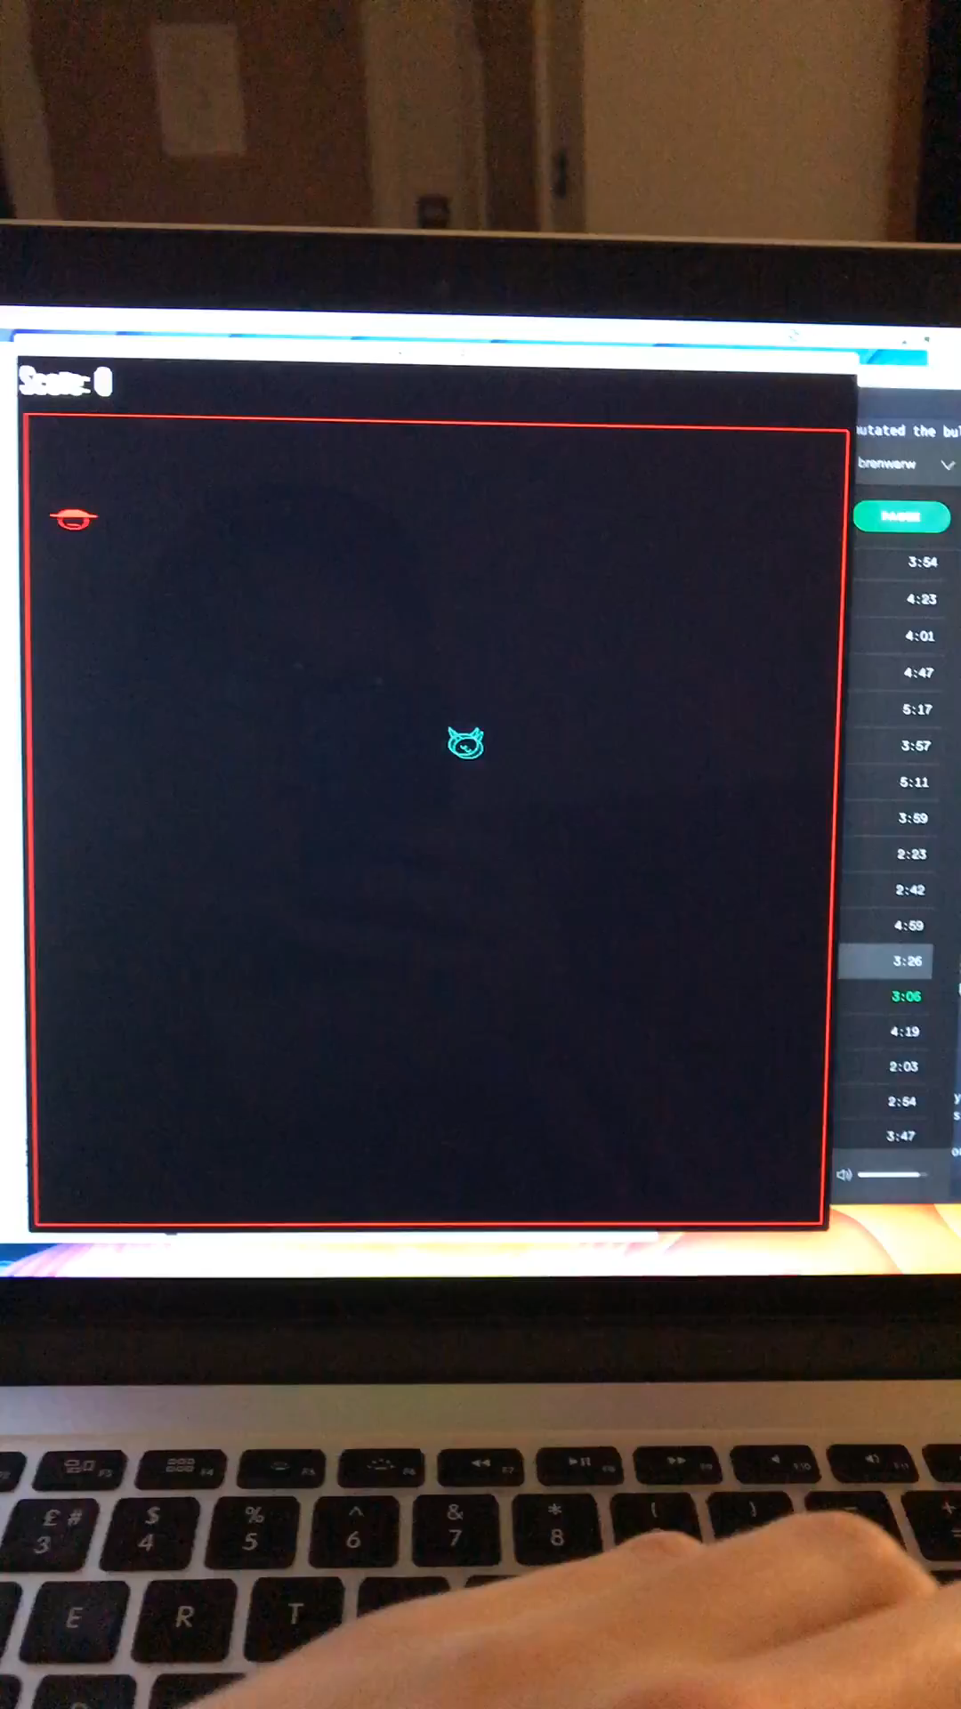
Video her

Slide 5
What could be next?
Feature
Feature
Feature
Feature

Slide 6
How it works
Stores offline etc
Sentinel data etc
Shows landmarks etc

Slide 7
Competitors
AiR isn’t against the grain, it goes with it.

Slide 8
High Value Proposition
This tech is patentable
Business model

Slide 9
Market Roadmap

